Slide 1
Weekly update
Batbot hovering by means of evolutionary algorithm
安武
2023/04/17

Slide 2
TABLE OF CONTENT
Last Presentation Goals
Last Weeks Achievements
Next Week Goa

Slide 3
last Presentation goals
Redo the calibration experiments a couple of times to ensure that the values remain constant in different situations.
Write Thesis Proposal
Start working on flight command algorithm with the STM32.

Slide 4
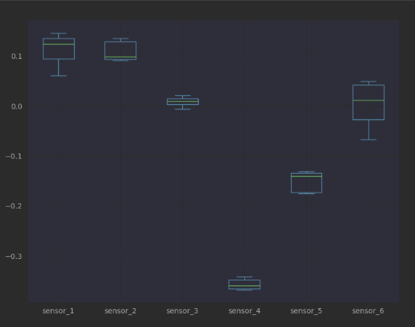
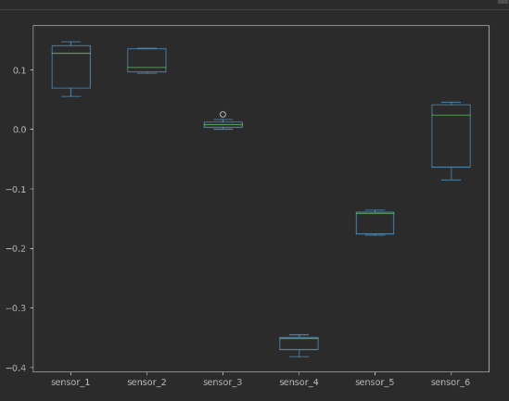
last weeks achievements
Redid the calibration experiments a couple of times to ensure that the values remain constant in different situations.
Original Test
Repetition
Notes:
Mention this and that

Slide 5
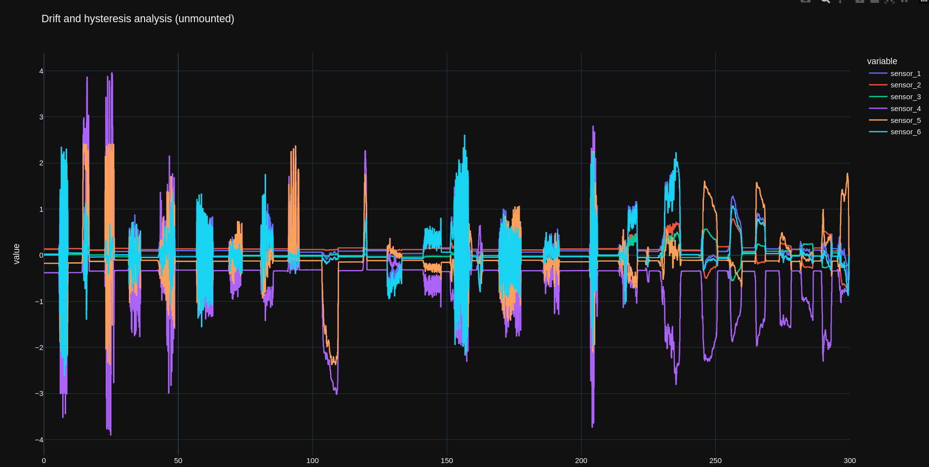
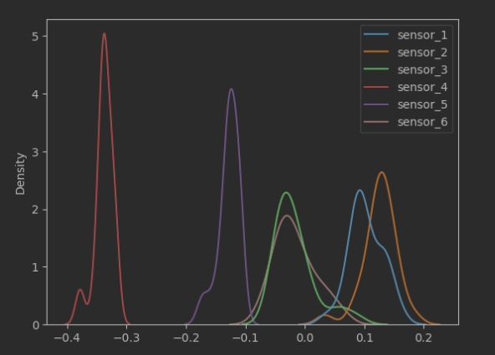
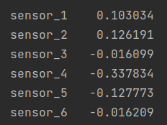
last weeks achievements
Did experiment with dynamic forces and torques. Used its results so describe the sensor neutral values.
Note: Preliminary results, repeat experiments with Batbot
Notes:
Mention that and this

Slide 6
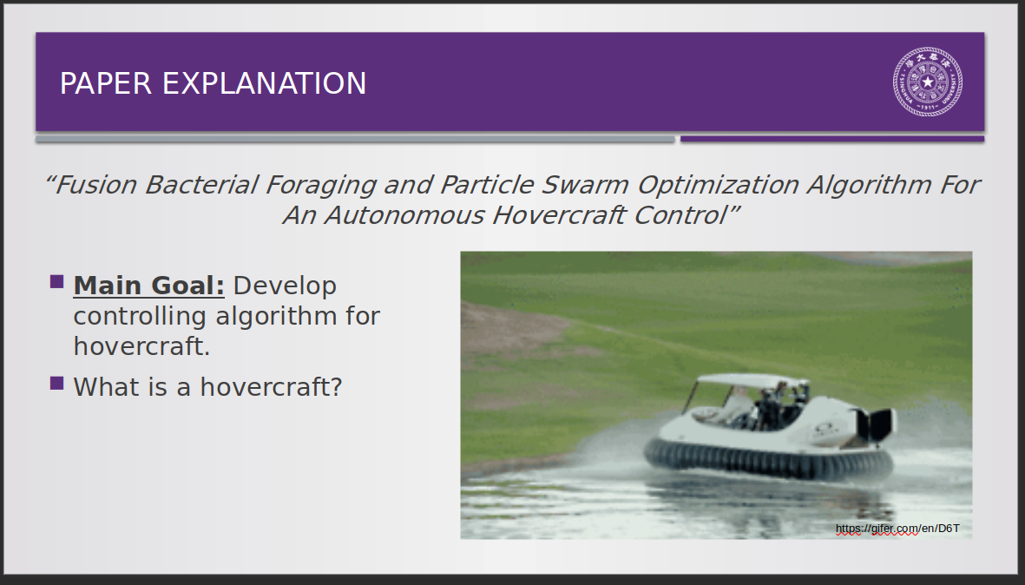
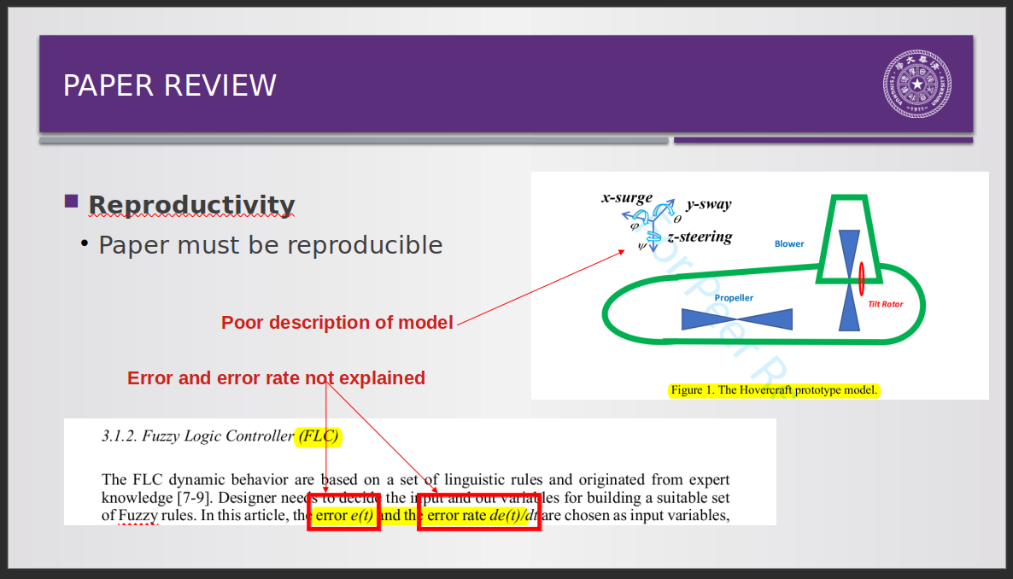
last weeks achievements
Finished first draft of “Scientific Writing Presentation”.

Slide 7
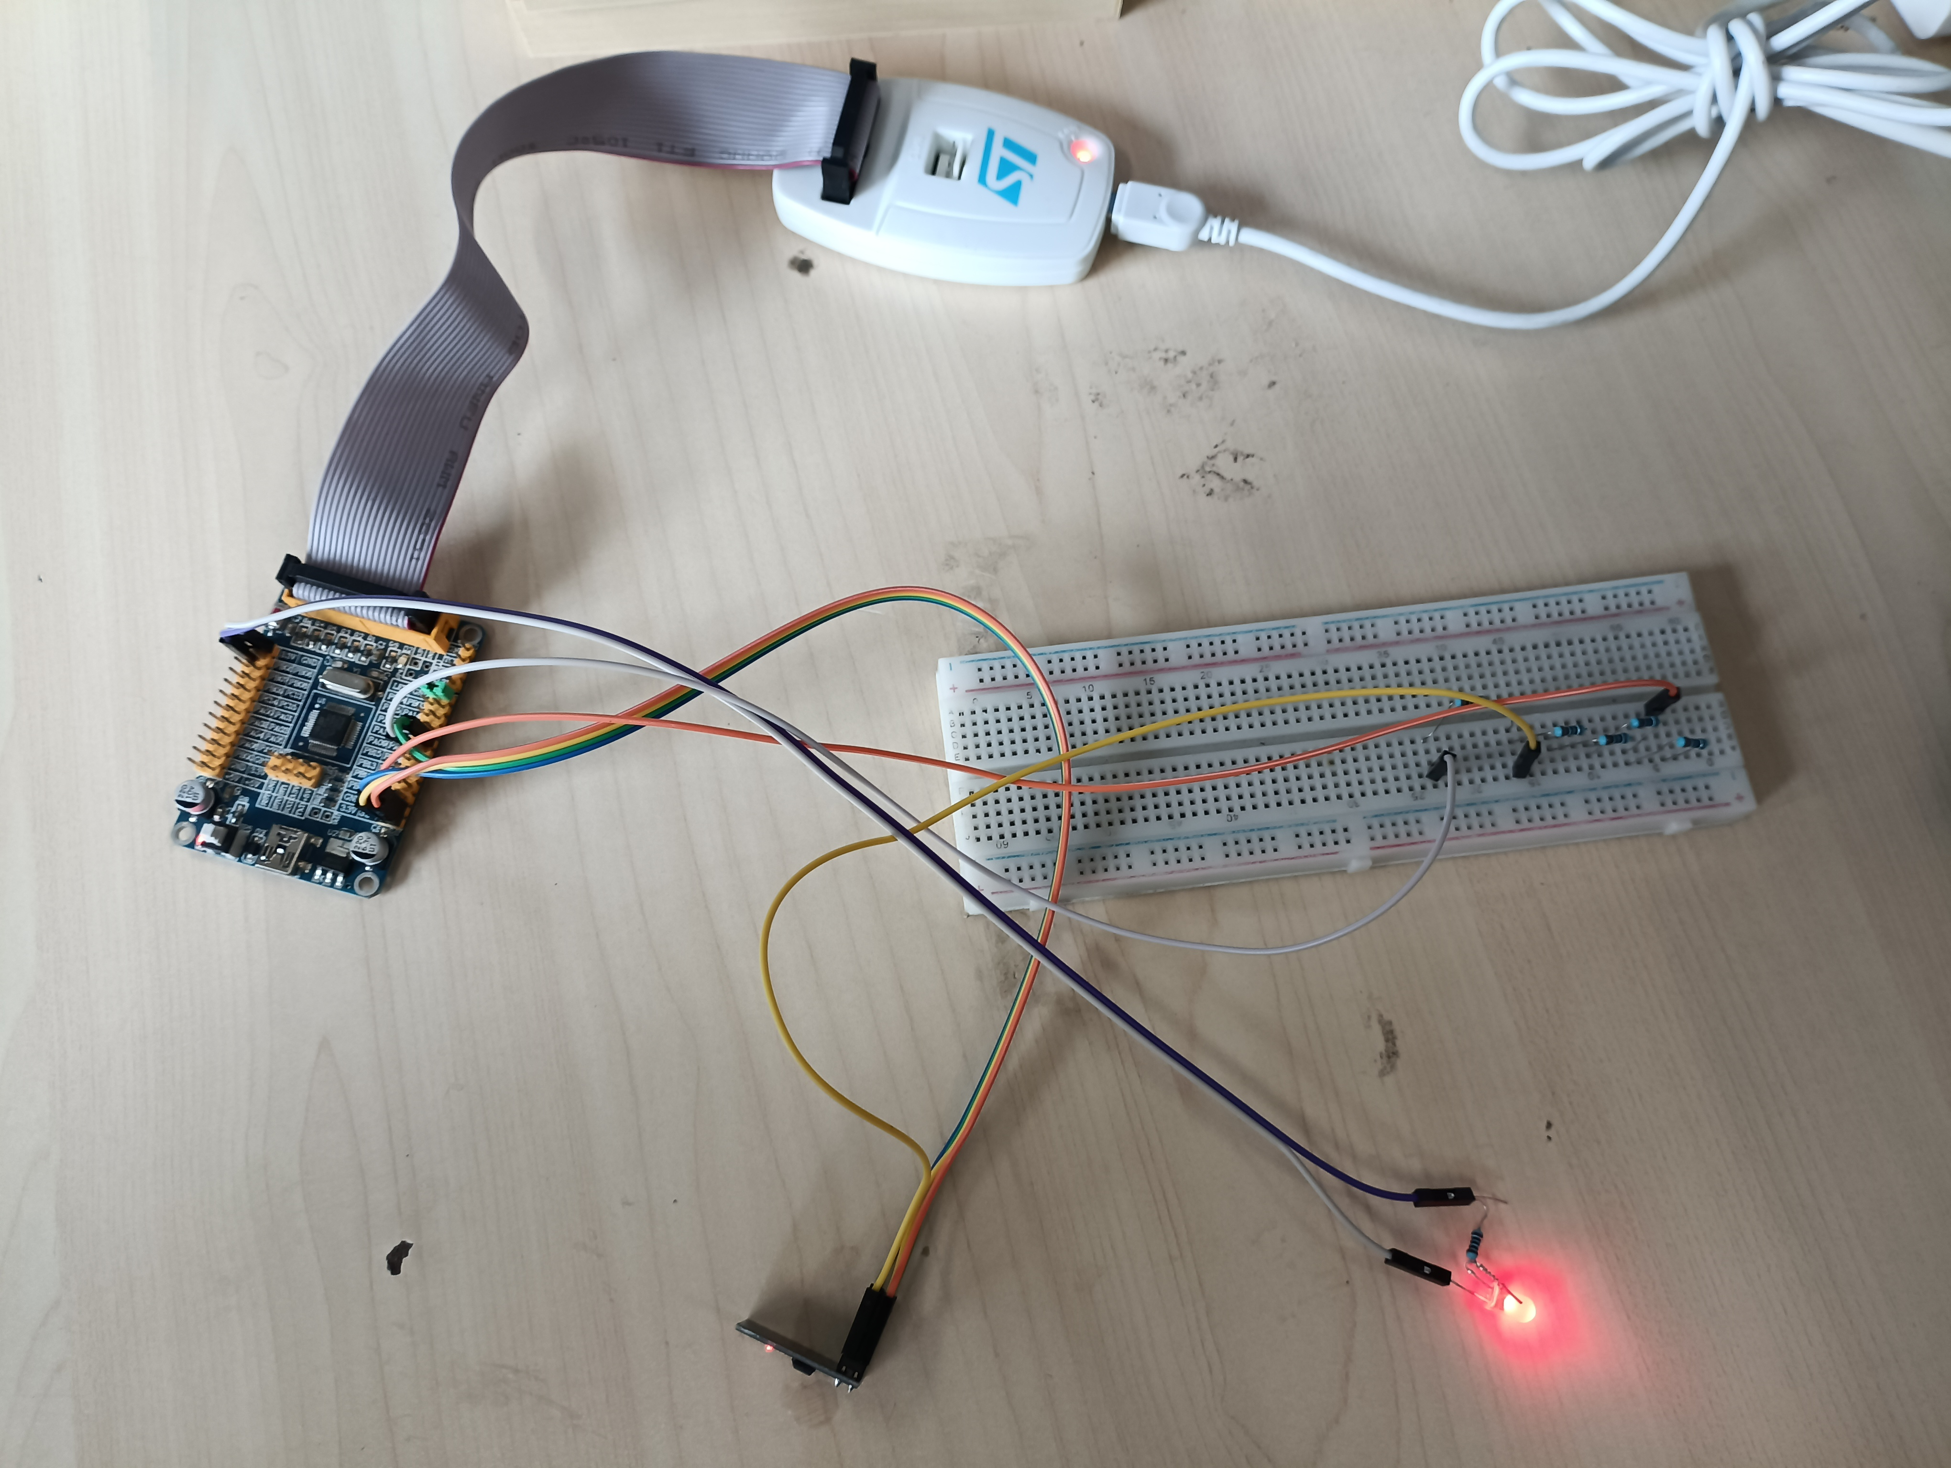
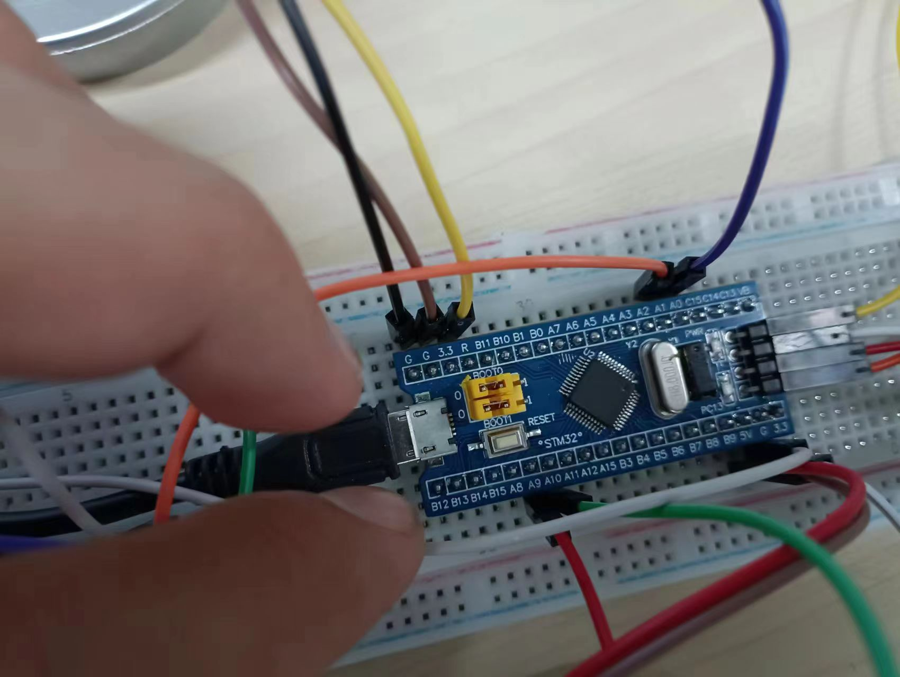
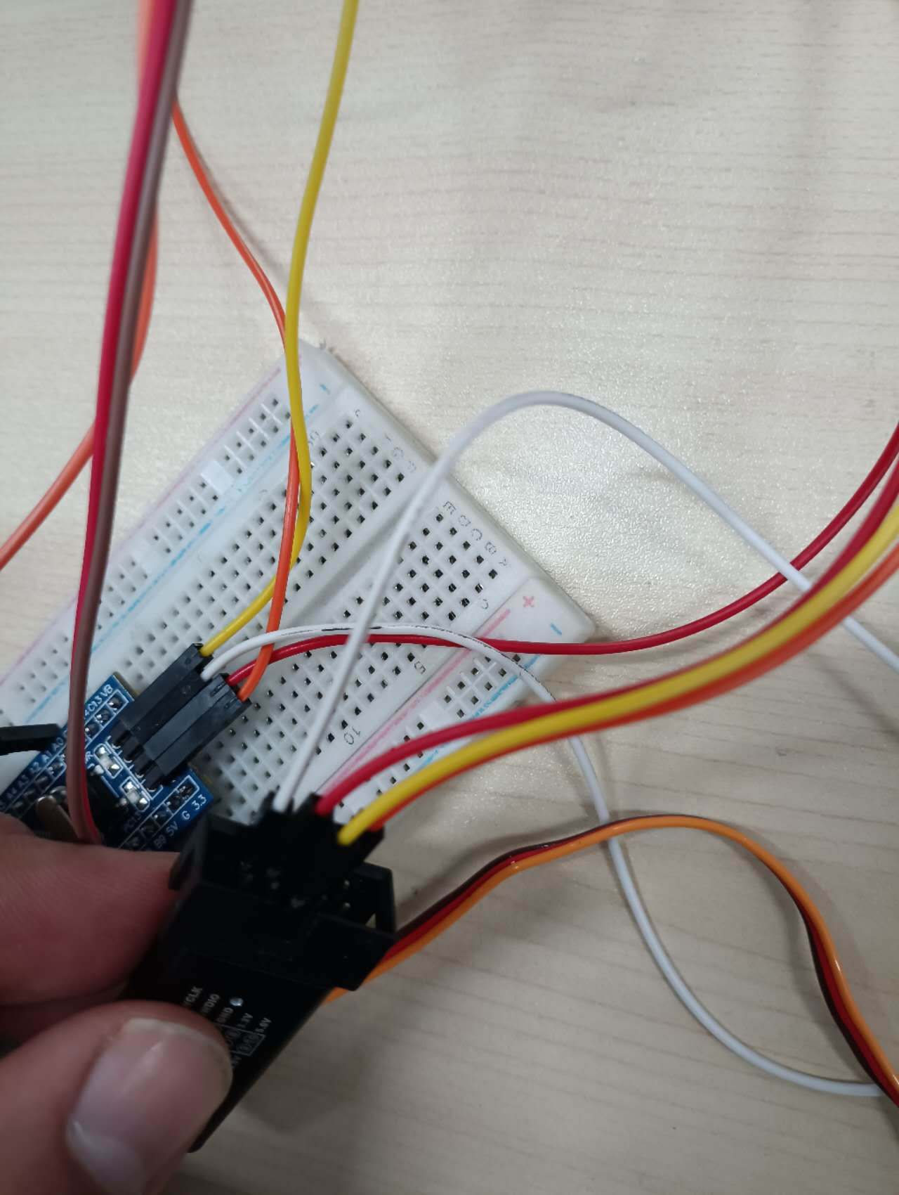
last weeks achievements
STM32 Command algorithm process started thanks to Ysé. The results of her project will be able to be directly implemented on the Batbot.

Slide 8
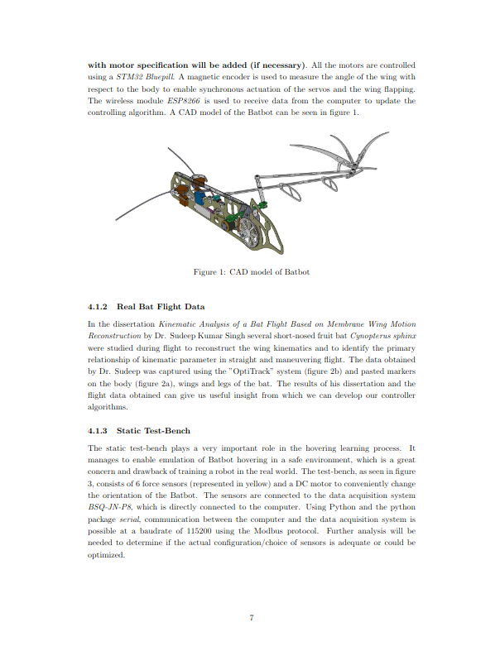
last weeks achievements
Finished Thesis Proposal
Restructured Problem Statement
Got much better understanding of project
Migrated from naive idea to more concrete research project
Created mathematical descriptions of problem at hand and proposed solutions

Slide 9
Next week goals
Refine Thesis Proposal (Today)
Start Batbot Feedforward Control design
Analysis of real Bat data and footage
STM32 programming

Slide 10
Thank you!

